Slide 1
Q ECE PROJECT DEFENSE ON DESIGN AND IMPLEMENTATION OF ARDUINO BASED INTERNET OF THINGS HOME AUTOMATION SYSTEM
Presented by:
Chukwu, Okwuchukwu Ogechukwu 2013/188425
Okolo, Chukwudi Christian 2013/187468
On
8th August 2018
Supervisor
Dr. V.C. Chijindu

Slide 2
PRESENTATION OUTLINE
INTRODUCTION(problem statement, aim(to do the title of your work) and objectives), scope
LITERATURE REVIEW(the review of the previous work and the existing work - - state the year and names of the authors; review the technologies used and what you have used…only list them) Finally give a summary of the methods(technology) you have used to achieve your aim
METHODOLOGY(Here you can give a structure of the methodology)
DESIGN AND IMPLEMENATAION(design is the circuit diagram implementation includes the screenshots of the designed work module by module)
RESULTS AND TESTING (Here you show the system integration, the way it would run when it been used)
CONCLUSION AND RECOMMENDATION – (Conclusion of what we did -pointing to our objectives- summarizing how we realized each objectives. It has to be in bullet point…the first one is the general statement, here you state the challenges we coulnt accomplish, we also recommend extra things to be done)

Slide 3
PROBLEM STATEMENT
The inability to control home devices remotely.
The difficulty in switching and controlling home devices.
The excess energy expended in other to have total control over ones home.
AIM
The aim of this project is to design and implement an arduino based internet of things home automation system
OBJECTIVES
Efficient control and management of lighting systems and cooling systems in the home.
Better and easier means of communication between the user and his automated devices using a mobile application.
Efficient energy management of home devices

Slide 4
SCOPE
Design of a home automated system using arduino UNO.
Internet of things which are the cooling system and lighting system of a home using arduino and android application.
Temperature system monitoring of a home.
BENEFITS OF THE SYSTEM
More efficient way of controlling home appliances
Saving of time, effort and money
Reduction of heating and cooling cost
Ability to monitor and control home devices remotely

Slide 5
LITERATURE REVIEW REVIEWED WORK 1
EMBEDDED SYSTEM FOR HOME AUTOMATION USING SMS
By Sougata Das, Nilava Debabhuti, Rishabh Das, Sayantan Dutta and Apurba Ghosh
FEATURES
Wireless control
GSM technology
Short message service
STRENGTH
No internet connection or access is required
LIMITATION
GSM has no friendly graphical user interface (GUI)

Slide 6
REVIEWED WORK 2
ANDROID BASED HOME AUTOMATION USING RASPBERRY PI
By Shaijupaul, Ashlin Anthony, Aswathy B
FEATURES
Raspberry Pi
Wi Fi communication protocol
STRENGTH
Raspberry Pi has a high processor speed.
LIMITATIONS
In relation to our proposed system, Raspberry Pi technology is quite expensive
Raspberry Pi does not support X86 operating systems

Slide 7
ADVANTAGES OF THE TECHNOLOGY USED IN THIS WORK
The Arduino technology was used in this work and its advantages includes the following
Ready to use
Example codes
Effortless functions
Large community
Inexpensive
Cross platform
Open source and extensible hardware and software

Slide 8
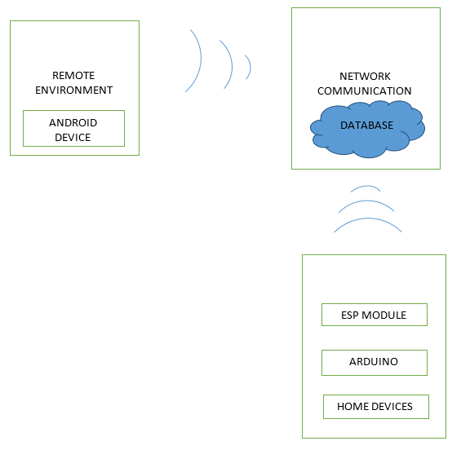
METHODOLOGY
This work is segmented into three modules: Home Environment, Remote Environment and The Network Communication Layer.

Slide 9
SYSTEM DESIGN AND IMPLEMENTATION
The two major systems making up the entire work are:
The hardware system
The arduino microcontroller
The android smartphone
The software system
android program
the arduino program.

Slide 10
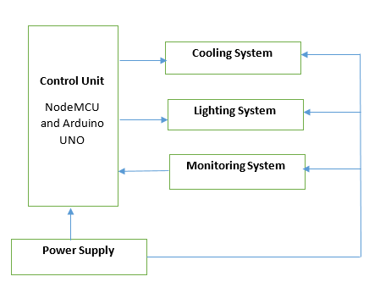
1. Arduino controller and its subsystem
The block diagram of the hardware system

Slide 11
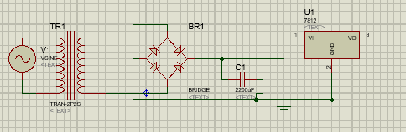
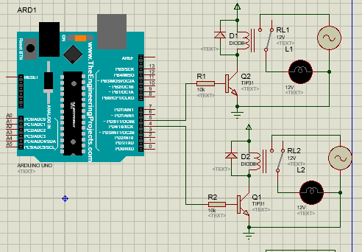
Power Supply Unit and Switching Unit Circuit Design

Slide 12
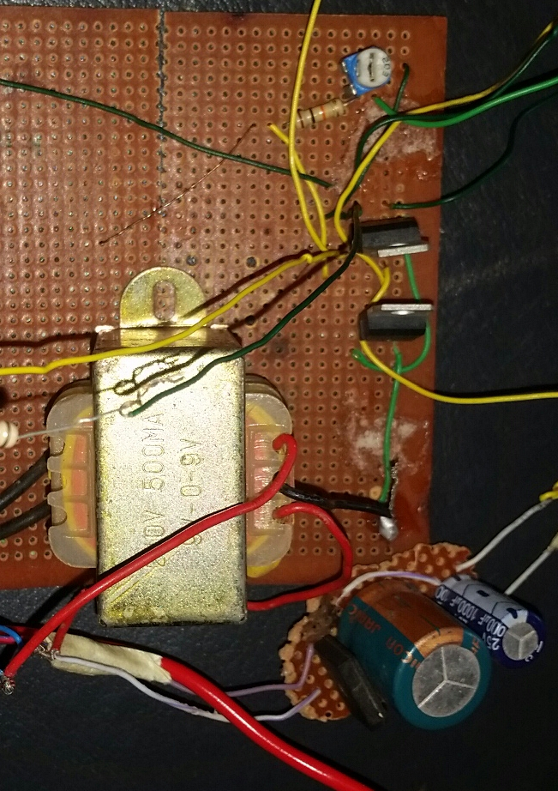
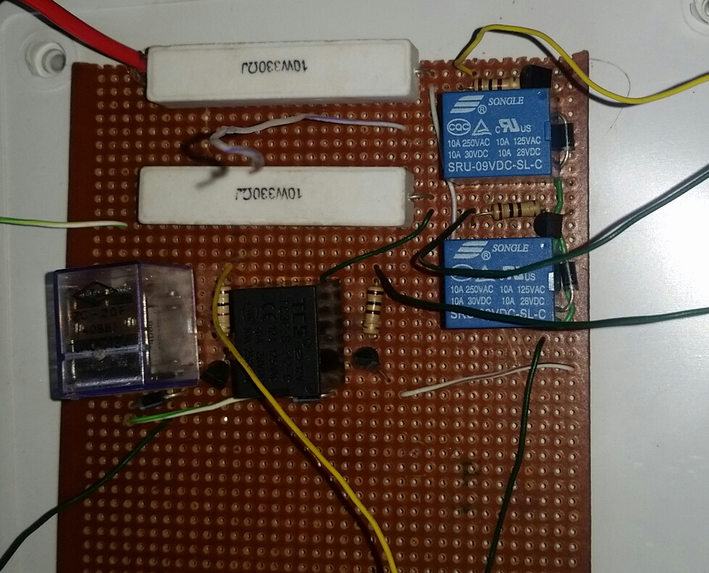
Power Supply and Switching Unit Circuit Implementation

Slide 13
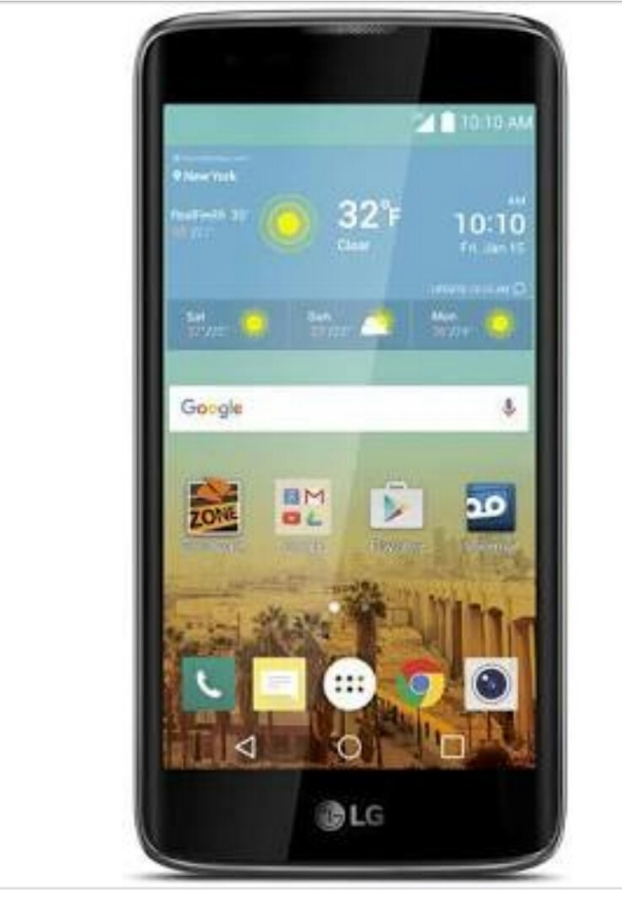
2. The Android Smartphone

Slide 14
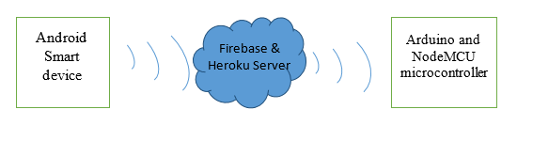
THE SOFTWARE SYSTEM
The software system comprises of the android program and the arduino program. The interaction between them gives the resultant software system interaction diagram as shown below.

Slide 15
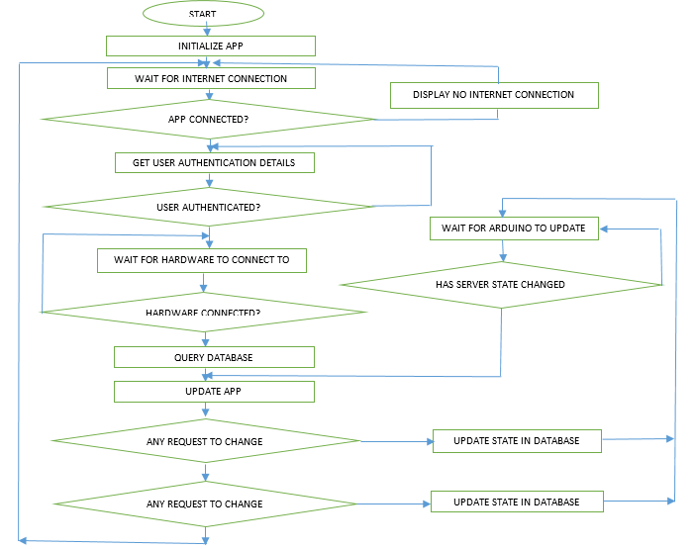
THE ANDROID PROGRAM

Slide 16
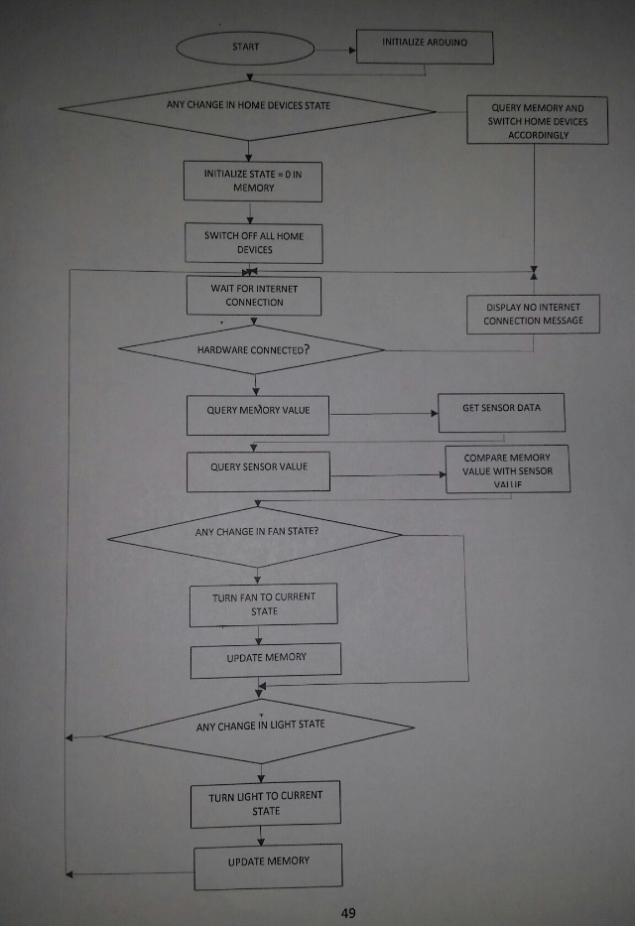
THE ARDUINO PROGRAM

Slide 17
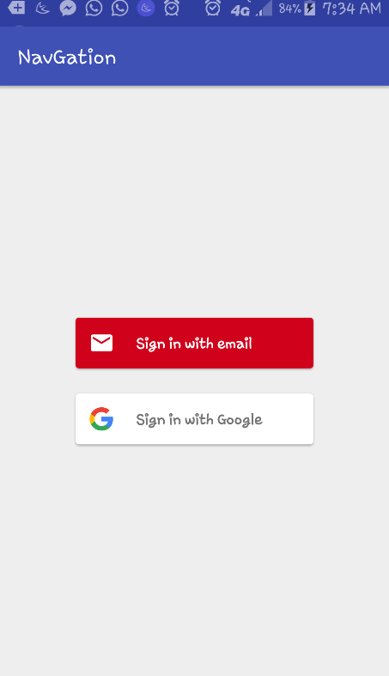
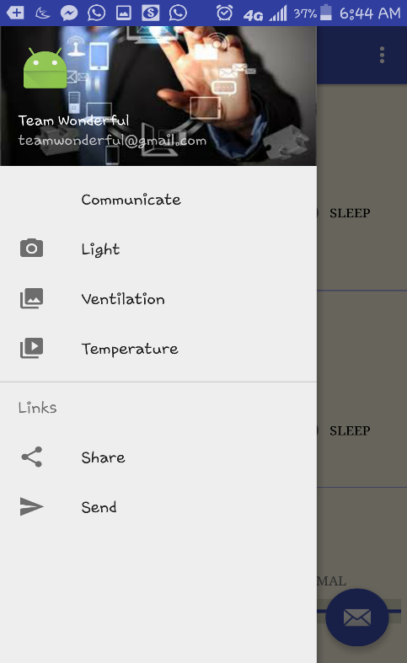
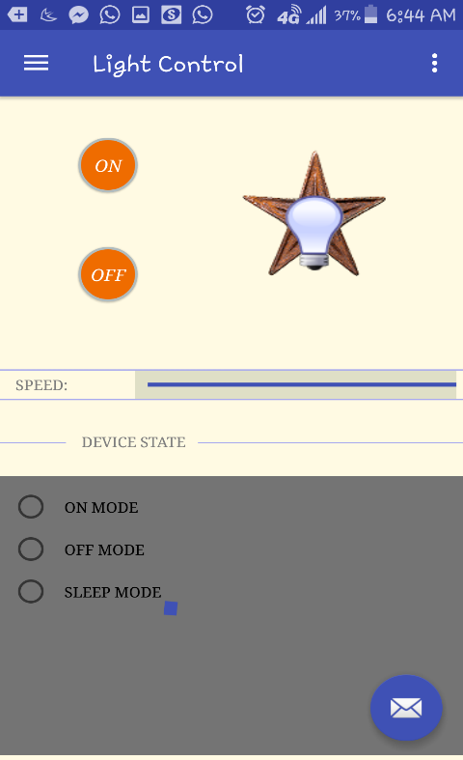
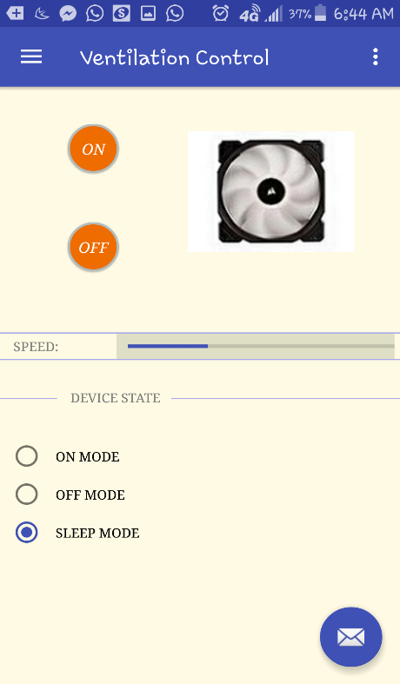
SYSTEM TESTING AND RESULT
The android program was designed to have a friendly graphical user interface that enables the homeowner control his home devices efficiently.

Slide 18
CONCLUSION AND RECOMMENDATION
CONCLUSION - By this work, we have been able to present an arduino based internet of things home automation system.
Arduino UNO microcontroller was able to switch the home devices efficiently and appropriately depending the request made by the user via the mobile app.
The switching of the home devices included a SLEEP mode for efficient energy management
Also poor internet connectivity limits the efficiency of the system
Arduino UNO does not have a direct internet connection capability hence NodeMCU was used to complement this limitation
Android phones with API levels less than 21 cannot run the android application
RECOMMENDATIONS
Support more android smartphones versions
Automation of more home devicesa
Cross platform mobile application

Slide 19
THANK YOU

